Slide 1
Patent Analytics in India (2018–2022)
Using Power BI

Slide 2
Project Objective
Why patents matter for innovation:
- Goal: Trend analysis
- Assignee insights
- Technology field impact

Slide 3
Dataset Overview
• CSVs from 2018–2022 (~20K rows)
• Key fields: Assignee, Technology Field, Claims Count, Citations, Status

Slide 4
Data Preparation
- Cleaned duplicates & standardized names
- Handled missing values
- Measures in DAX:
* Total Patents
* Patents by Status
* Top Assignee Analysis
* Yearly Growth KPI

Slide 5
KPI Tracking
• KPI: Annual patent growth with target benchmark (10% YoY)
• 2020 met target
• 2021 fell short
• 2022 recovery

Slide 6
Status-wise Insights
• Granted patents dominated (11,029)
• Followed by Pending, Published, Withdrawn

Slide 7
Yearly Trends
• Growth in 2019–2020
• Dip during 2021 (pandemic impact)
• Recovery in 2022

Slide 8
Technology Field Insights
• Mechanical → highest claims count
• Electronics → highest citations

Slide 9
Top Assignees
• Tata Consultancy Services (1424 patents)
• Siemens, Infosys, Wipro followed
• TCS ~51% higher than Siemens India

Slide 10
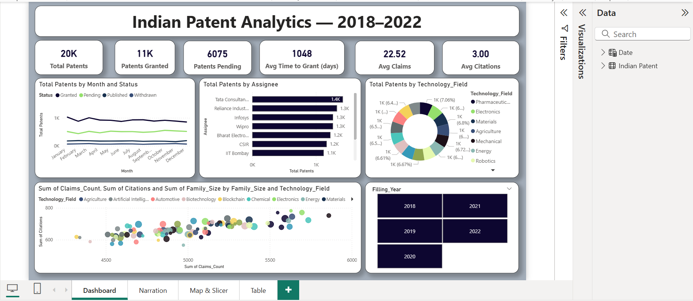
Dashboard

Slide 11
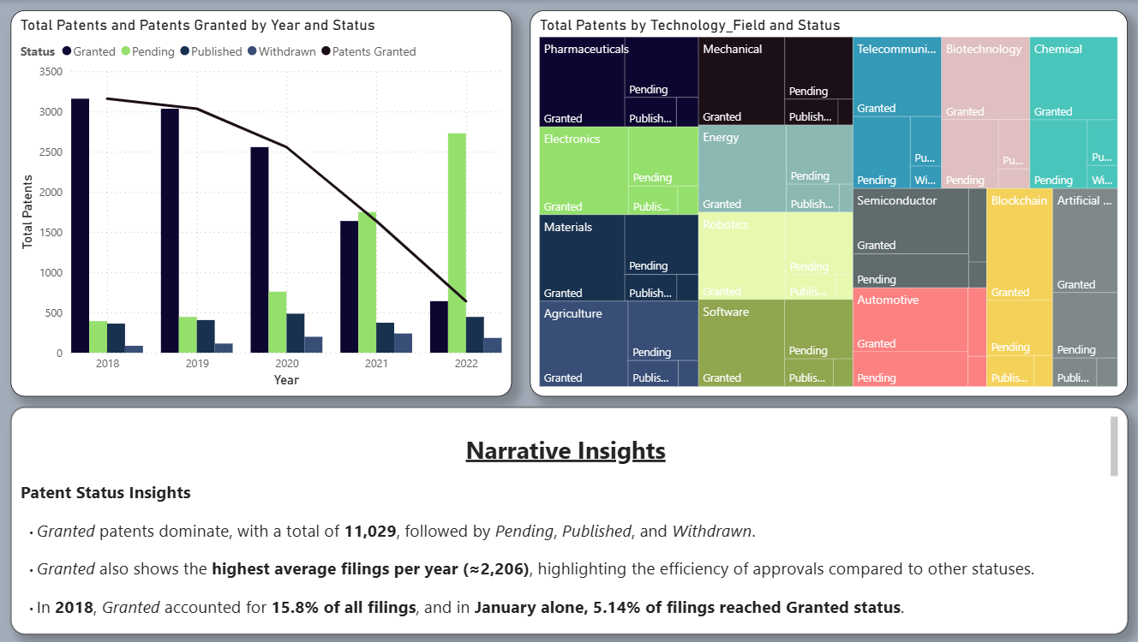
Narrative Insights

Slide 12
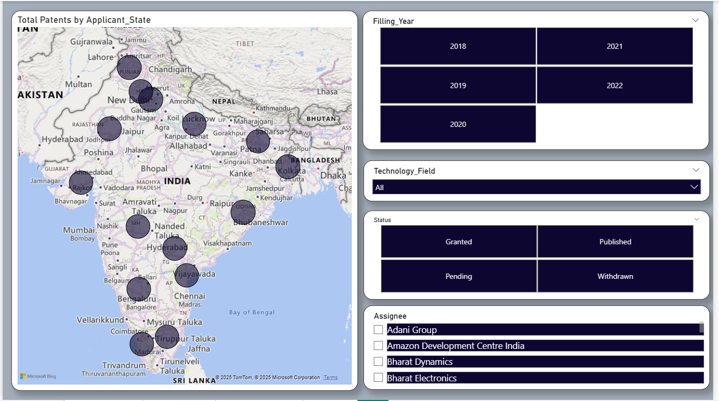
Map & Slicers

Slide 13
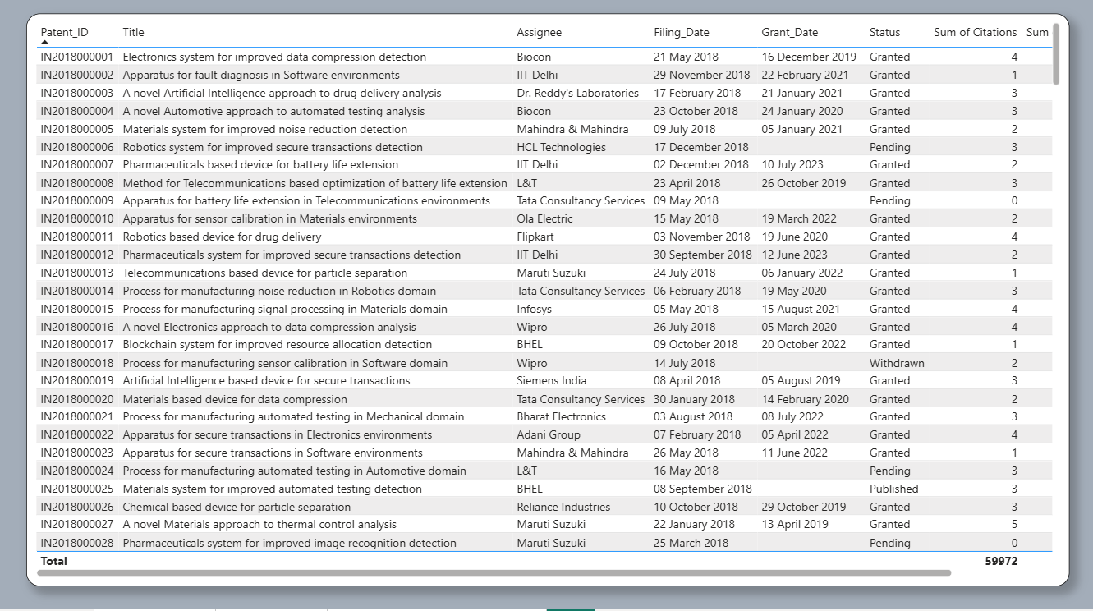
Table

Slide 14
Conclusion & Business Impact
- Patent filings show growth overall
- IT & Mechanical domains dominate
- Top companies: TCS & Siemens
- Action: Assignee benchmarking, IP strategy

Slide 15
Thank You

